Slide 1
Project Name
Waste Bin Design for Road Side
Team Name
“Safe Environment, Safe Life.”
Challenge
The Earth and Us
Team Members
Woakimul Islam Shakil
Alifa Tajmin
Tanvir Bin Mortaza
Muntasir Rabby

Slide 2
Our team is working with a view to keep earth environment safe and healthy by establishing good practice of solid waste management as well as used of waste bin.
Our aim is to keep environment free from pollution by proper waste management.
In this project , NASA Earth Science data is used with sociological and economic information to generate new understanding and perspectives on human-environment interactions.

Slide 3
Our project helps
To safe environment from scattering of waste.
To form a better practice to used waste bin among all level of people like children and adults.
To give better opportunity of waste management in earth.
To utilize and reuse of refuse plastic.

Slide 4
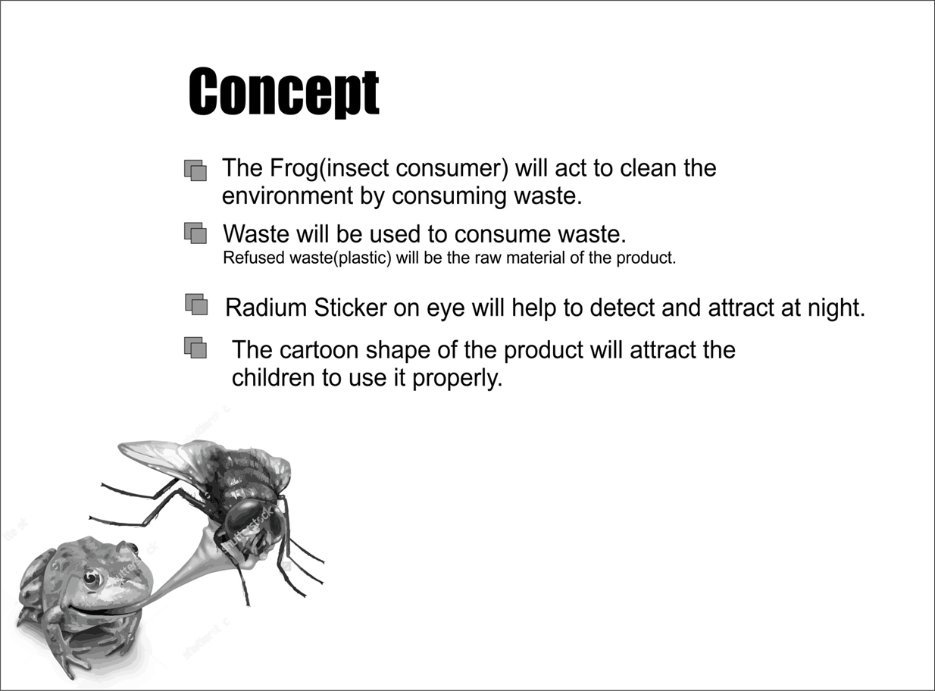

Slide 5
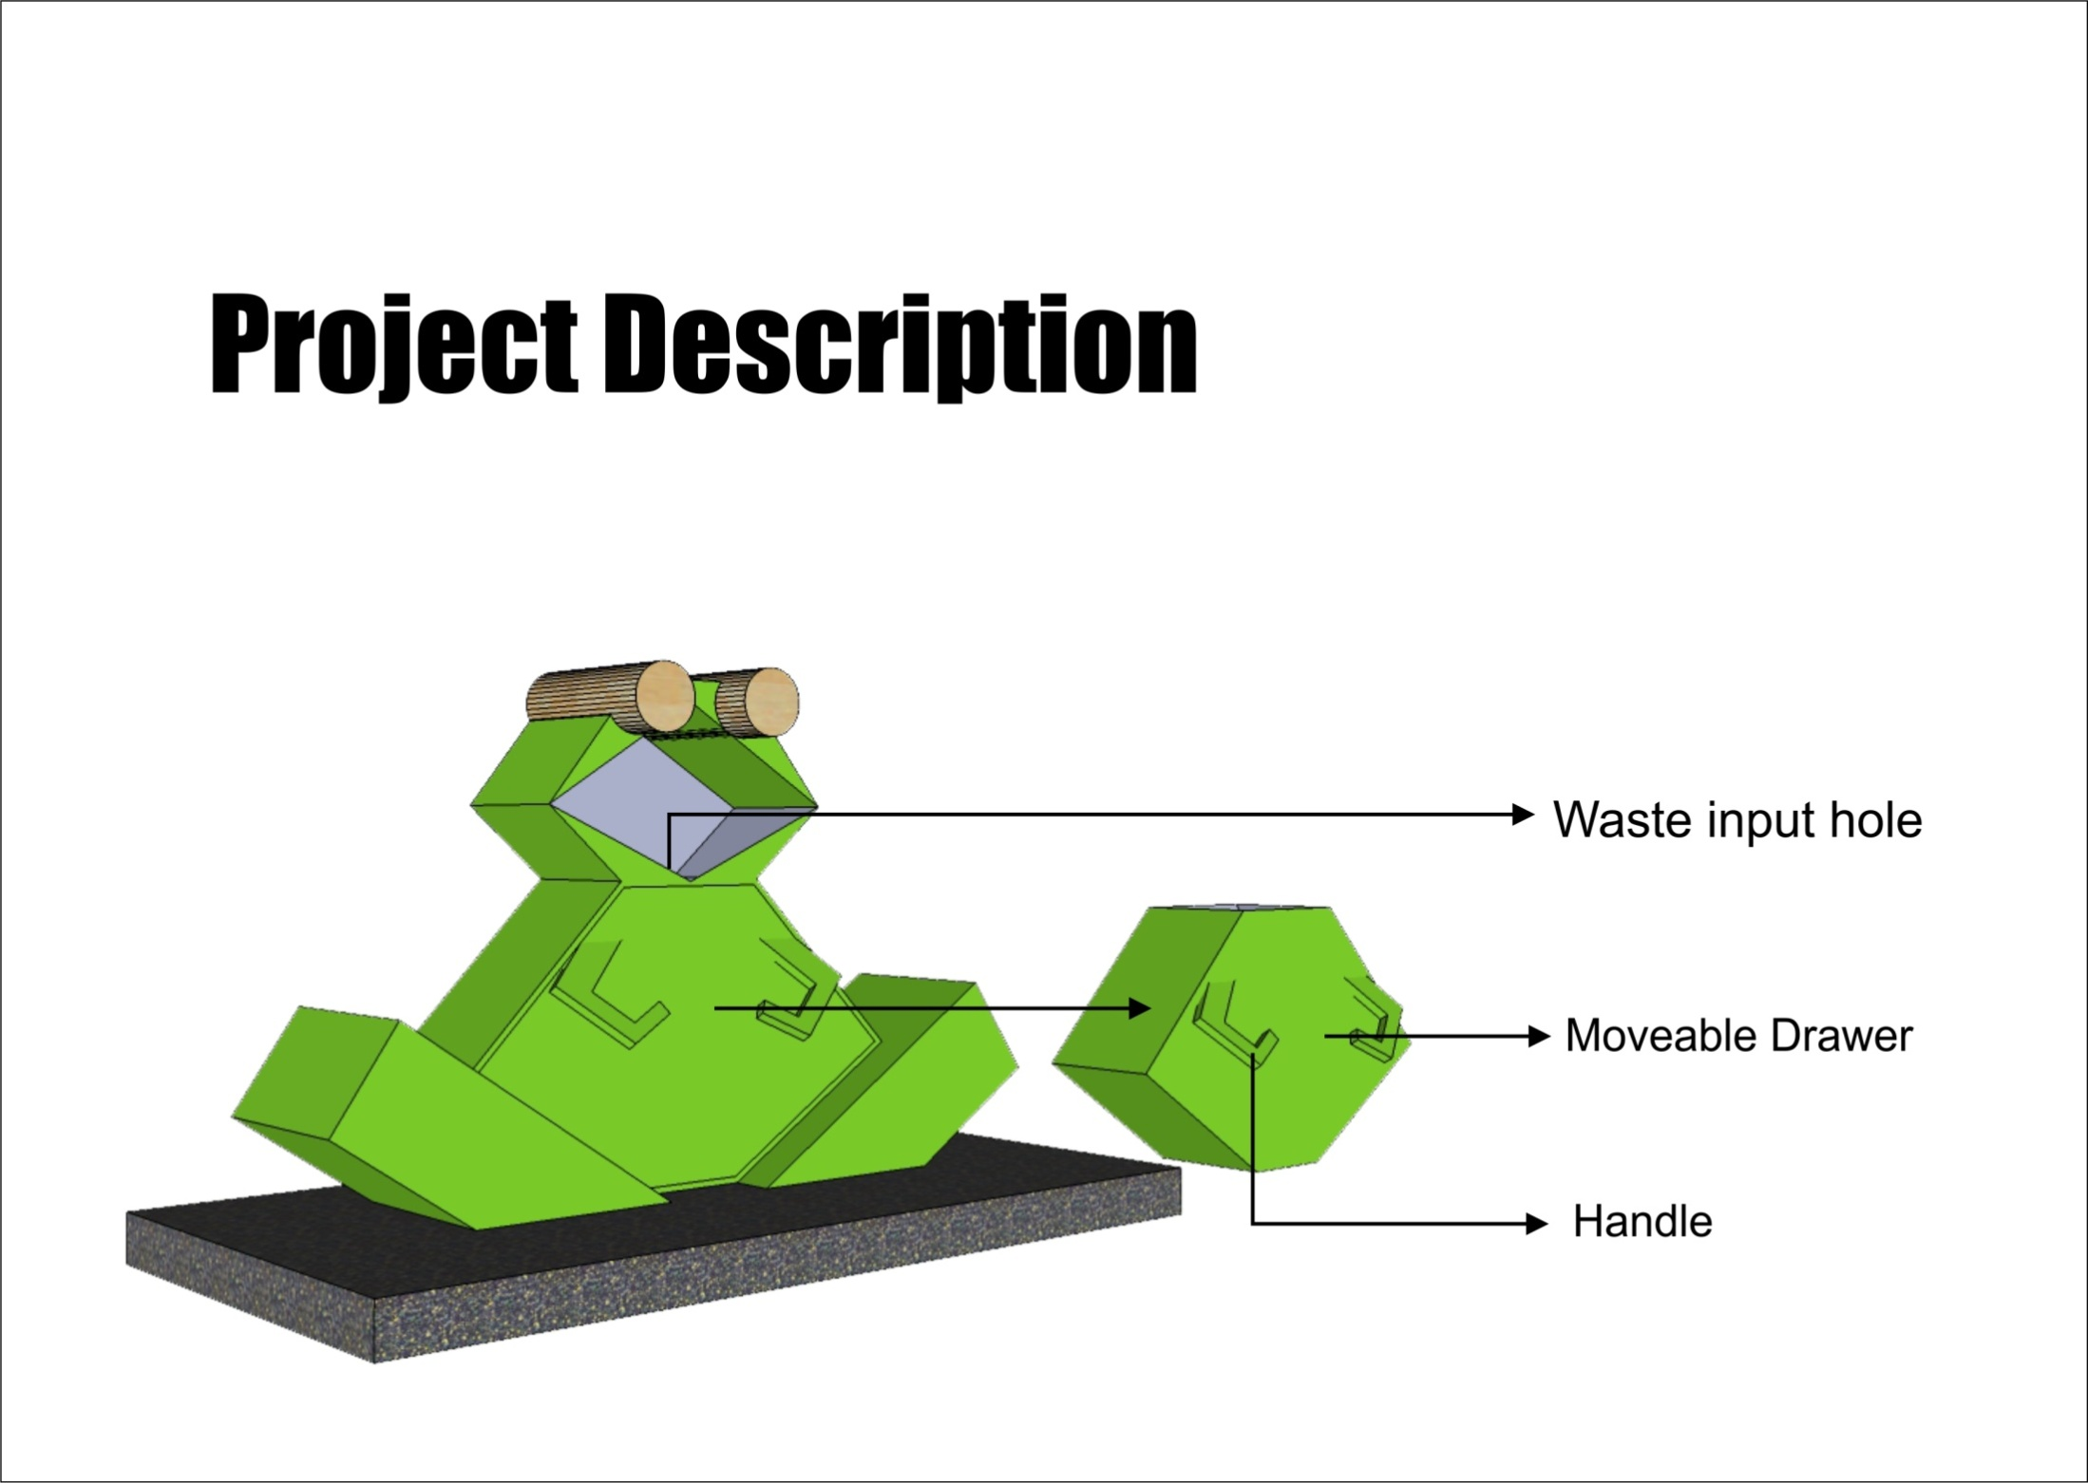
Radium Sticker

Slide 6
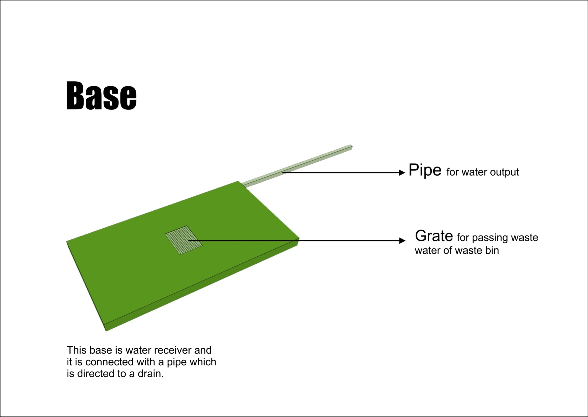

Slide 7
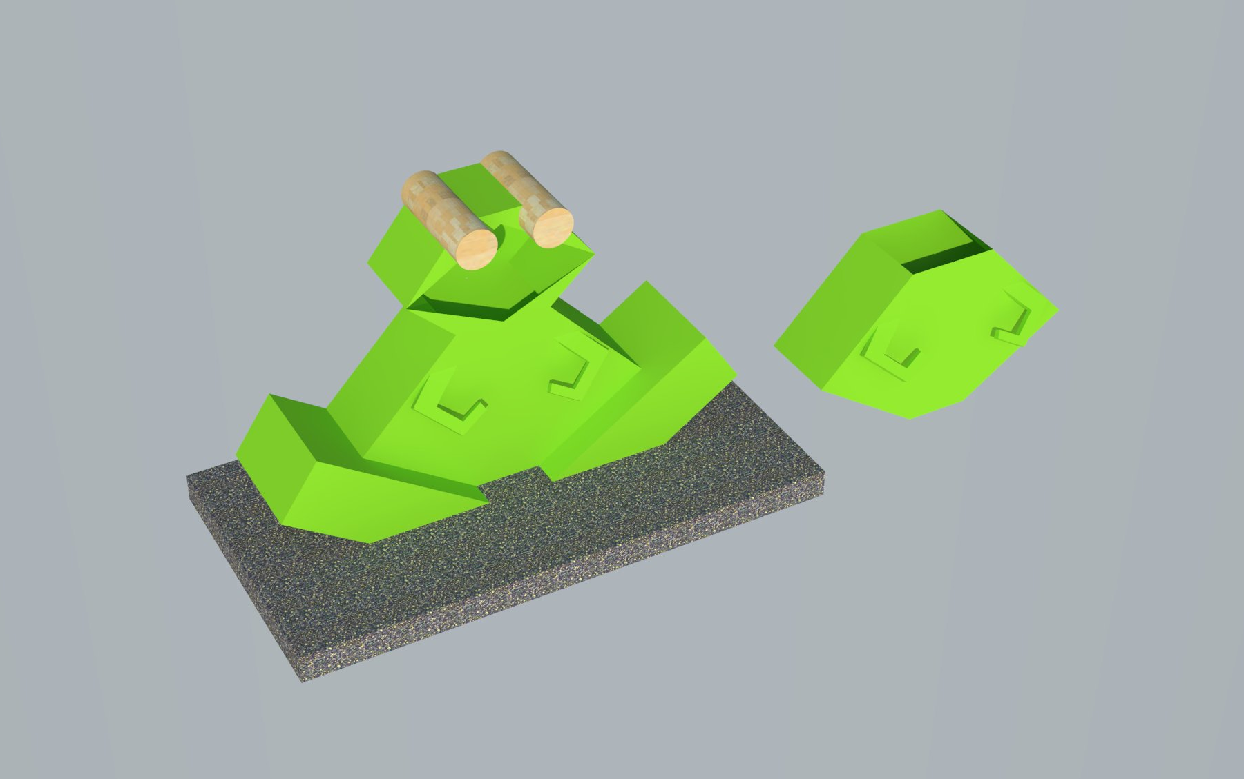
Outer View

Slide 8
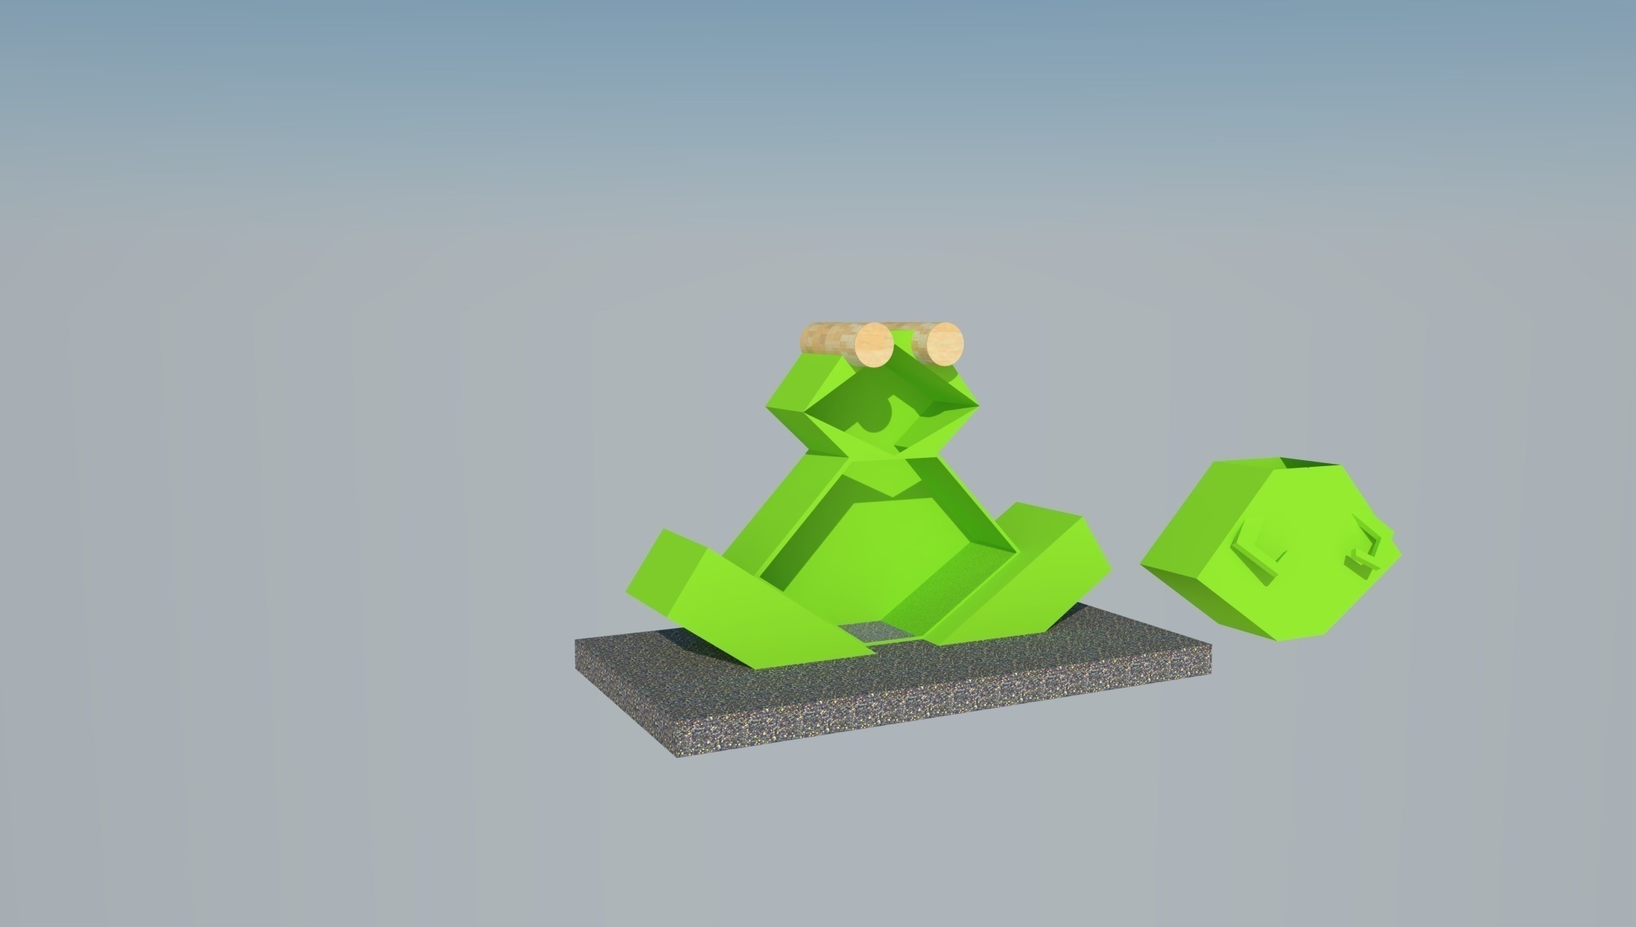
Inner View

Slide 9
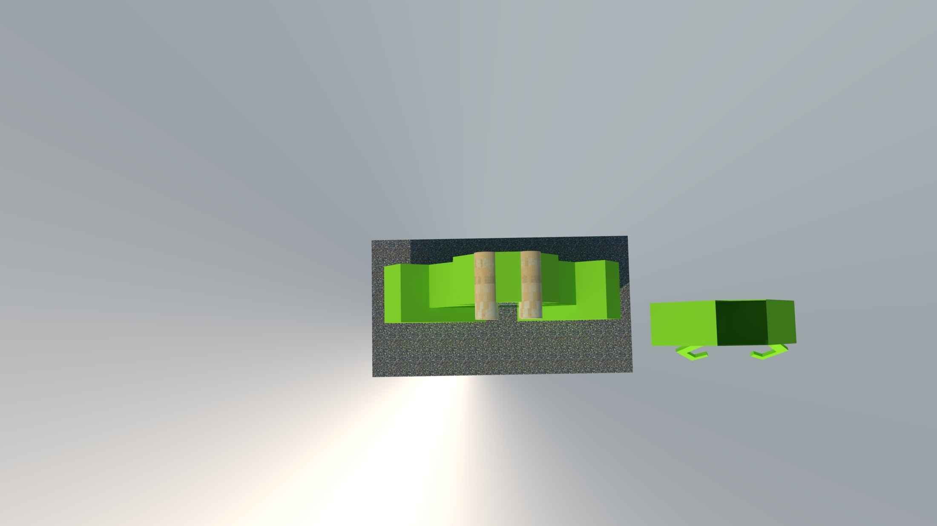
Upper View

Slide 10
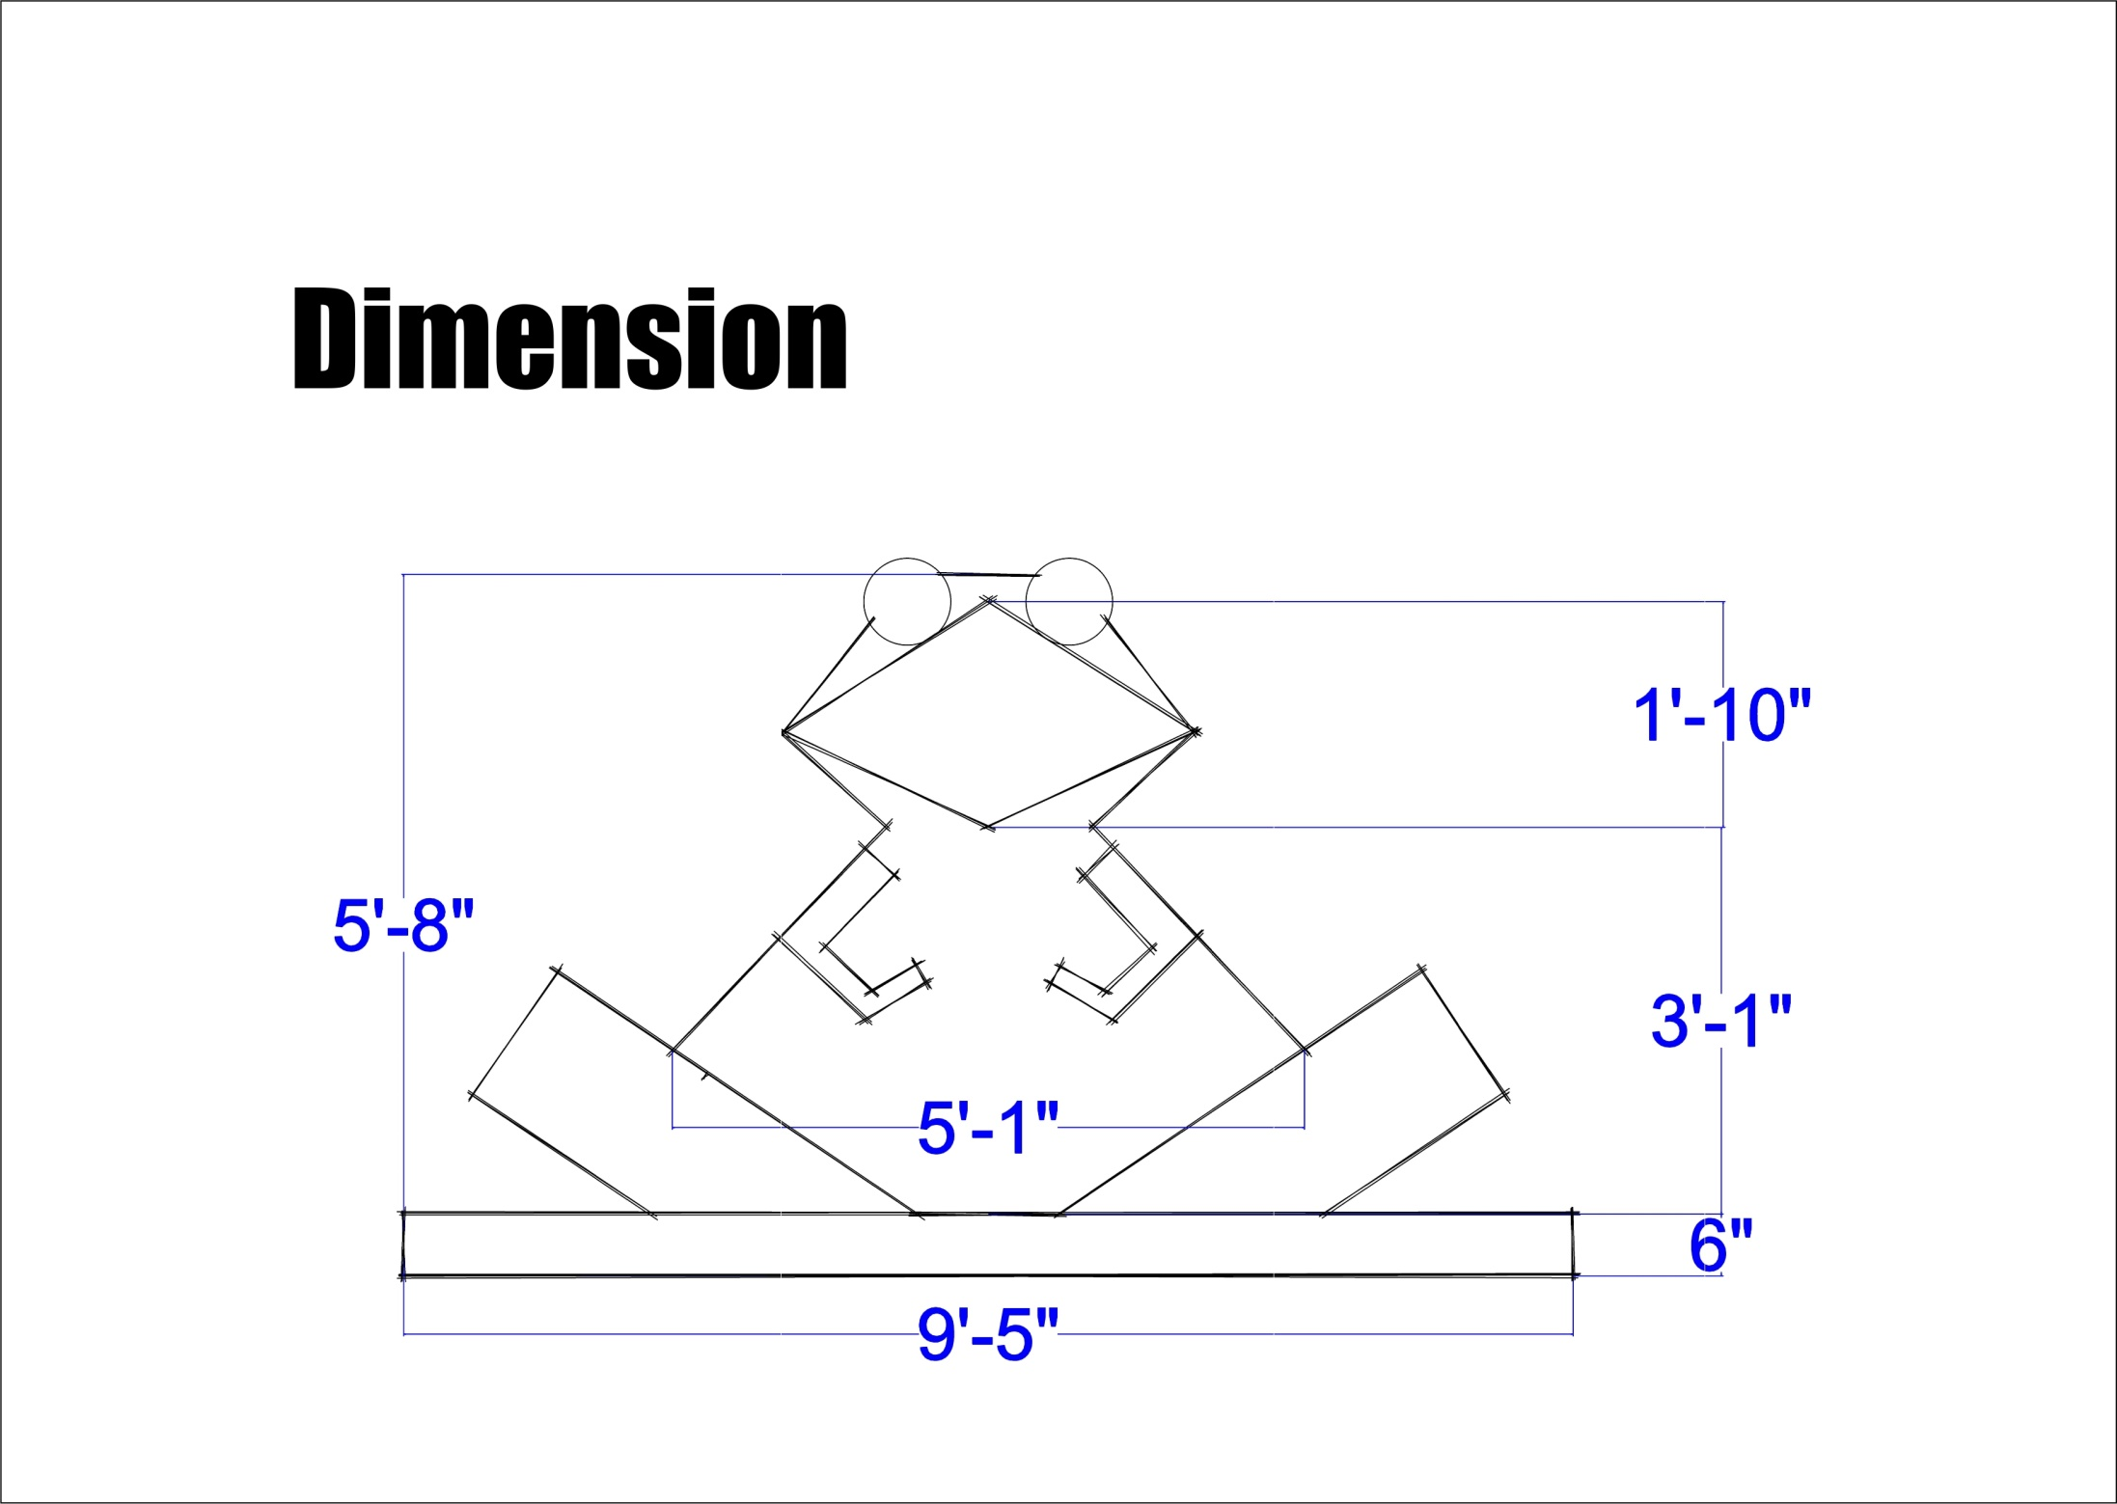

Slide 11
Raw Material:
1. Refused Plastic
2. Radium Sticker
3. Color
Specific Feature (why it is innovative):
1.Waste water basin(attached grate) is seated bottom of the
structure and its help to separate waste liquid(water) from waste.
2. Drawer system waste receiver is help for waste collector to
collect waste easily.
3. The cartoon shape of the product will attract the children to use it properly.
4. Radium Sticker on eye will help to detect and attract at night to users.

Slide 12
Implementation Strategy of the Project:
1. The refuse plastic is used as raw material of the project. Its helps to reduce plastic from environment.
2. It will be long lasting and production cost will be less. Mostly suitable in weathering.
3.The basin feature(attached grate) of this project is helpful for
separating waste water from storage waste. It will be reduced waste rotting rate for separating waste water.
4.Radium sticker will be helpful to detect waste bin at night.
5.Its setup beside road side especially in adult and children gathering areas.

Slide 13
Future and Sustainability of the Project :
1.The user can modify and add features as need in future .
2. Its enable to be modified to adjusting with modern technology.
3. Its enable to change human behavior to use waste bin as well as keep environment clean and healthy.
4. Its enable to add compress feature in future.
5. Its implemented with environmental sustainability.

Slide 14


